Slide 1
Program Verification: CEGAR
Course: CS60030
FORMAL SYSTEMS
Pallab Dasgupta
Professor,
Dept. of Computer Sc & Engg

Slide 2
Counterexample-guided Abstraction Refinement
“CEGAR”
An iterative method to compute a sufficiently precise abstraction
Initially applied in the context of hardware [Kurshan]

Slide 3
CEGAR Overview
C program
1. Compute Abstraction
2. Check Abstraction
[no error]
OK
4. Refine Predicates
3. Check Feasibility
[feasible]
report counterexample

Slide 4
Counterexample-guided Abstraction Refinement
Claims:
This never returns a false error.
This never returns a false proof.
This is complete for finite-state models.
But: no termination guarantee in case of infinite-state systems

Slide 5
Computing Existential Abstractions of Programs
C program
1. Compute Abstraction
2. Check Abstraction
[no error]
OK
4. Refine Predicates
3. Check Feasibility
[feasible]
report counterexample

Slide 6
Computing Existential Abstractions of Programs
void main ( ) {
bool p1 , p2 ;
p1=TRUE ;
p2=TRUE ;
while ( p2 ) {
p1 = p1 ? FALSE : * ;
p2= !p2 ;
}
}
int main ( ) {
int i ;
i = 0 ;
while ( even ( i ) )
i+ + ;
}
p₁ ⇔ i=0
p₂ ⇔ even(i)
+
C Program
Predicates
Boolean Program
Minimal?

Slide 7
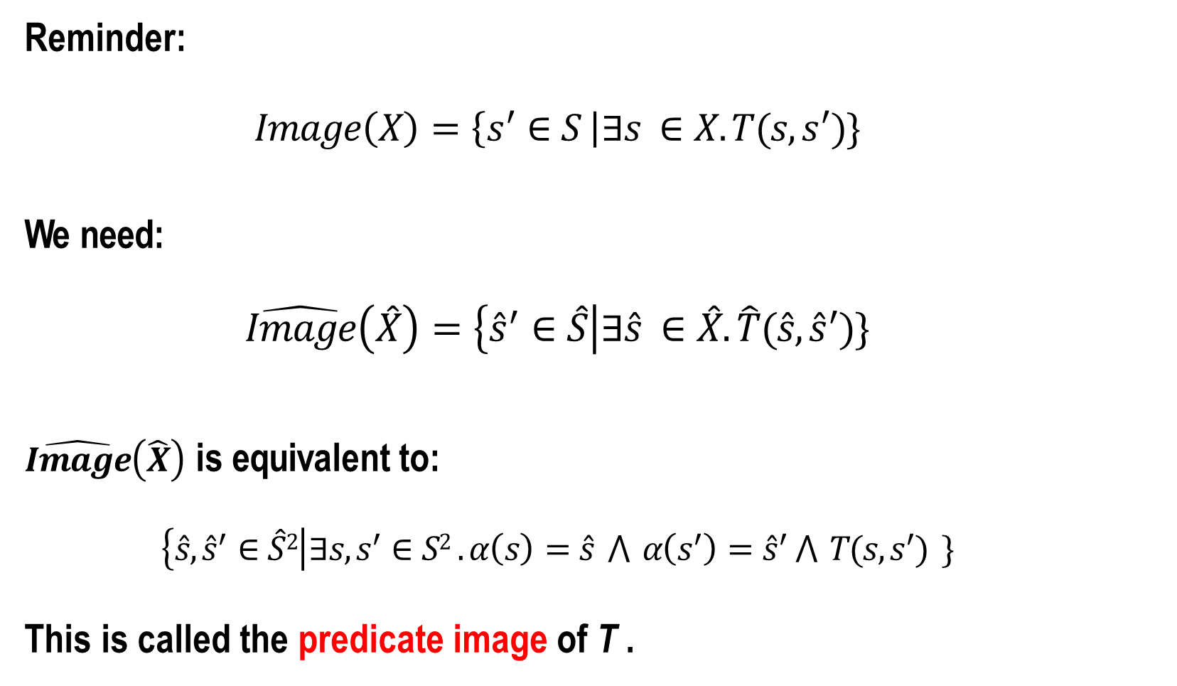
Predicate Images
Reminder:
$$Image\left(X\right)=\left\{s^{′}∈S \right|∃s ∈X. T(s,s^{′})\}$$
We need:
$$\hat{Image}\left(\hat{X}\right)=\left\{{\hat{s}}^{′}∈\hat{S}\right|∃\hat{s} ∈\hat{X}.\hat{T}(\hat{s},{\hat{s}}^{′})\}$$
$\hat{Image}\left(\hat{X}\right)$ is equivalent to:
$$\left\{{\hat{s}, \hat{s}}^{′}∈\hat{S}2\right|∃s,s^{′}∈S2 .α\left(s\right)=\hat{s} ⋀ α\left(s^{′}\right)={\hat{s}}^{′} ⋀ T(s,s^{′}) \}$$
This is called the predicate image of T .

Slide 8
Enumeration
Let’s take existential abstraction seriously
Basic idea: with n predicates, there are 2^{n} · 2^{n} possible abstract transitions
Let’s just check them!

Slide 9
Enumeration: Example
Predicates
p₁ | ⇐⇒ | i = 1
p₂ | ⇐⇒ | i = 2
p₃ | ⇐⇒ | even(i)
Basic Block
T
i ++;
i'= i + 1
p₁ p₂ p₃
p'₁ p'₂ p'₃
?
Query to Solver
0 | 0 | 0
0 | 0 | 1
0 | 1 | 0
0 | 1 | 1
1 | 0 | 0
1 | 0 | 1
1 | 1 | 0
1 | 1 | 1
✘
0 | 0 | 0
0 | 0 | 1
0 | 1 | 0
0 | 1 | 1
1 | 0 | 0
1 | 0 | 1
1 | 1 | 0
1 | 1 | 1
i ≠ 1 ∧ i ≠ 2 ∧ even(i) ∧
i' = i + 1∧
i' ≠ 1 ∧ i' ≠ 2 ∧ even(i')

Slide 10
Enumeration: Example
Predicates
p₁ | ⇐⇒ | i = 1
p₂ | ⇐⇒ | i = 2
p₃ | ⇐⇒ | even(i)
Basic Block
T
i ++;
i'= i + 1
p₁ p₂ p₃
p'₁ p'₂ p'₃
?
Query to Solver
0 | 0 | 0
0 | 0 | 1
0 | 1 | 0
0 | 1 | 1
1 | 0 | 0
1 | 0 | 1
1 | 1 | 0
1 | 1 | 1
✔
0 | 0 | 0
0 | 0 | 1
0 | 1 | 0
0 | 1 | 1
1 | 0 | 0
1 | 0 | 1
1 | 1 | 0
1 | 1 | 1
i ≠ 1 ∧ i ≠ 2 ∧ even(i) ∧
i' = i + 1∧
i' ≠ 1 ∧ i' ≠ 2 ∧ even(i')

Slide 11
Enumeration: Example
Predicates
p₁ | ⇐⇒ | i = 1
p₂ | ⇐⇒ | i = 2
p₃ | ⇐⇒ | even(i)
Basic Block
T
i ++;
i'= i + 1
p₁ p₂ p₃
p'₁ p'₂ p'₃
Query to Solver
0 | 0 | 0
0 | 0 | 1
0 | 1 | 0
0 | 1 | 1
1 | 0 | 0
1 | 0 | 1
1 | 1 | 0
1 | 1 | 1
0 | 0 | 0
0 | 0 | 1
0 | 1 | 0
0 | 1 | 1
1 | 0 | 0
1 | 0 | 1
1 | 1 | 0
1 | 1 | 1
. . . and so on . . .

Slide 12
Predicate Images
⌧ Computing the minimal existential abstraction can be way too slow
Use an over-approximation instead
✔ Fast(er) to compute
⌧ But has additional transitions
Examples:
Cartesian approximation (SLAM)
FastAbs (SLAM)
Lazy abstraction (Blast)
Predicate partitioning (VCEGAR)

Slide 13
Checking the Abstract Model
C program
1. Compute Abstraction
2. Check Abstraction
[no error]
OK
4. Refine Predicates
3. Check Feasibility
[feasible]
report counterexample

Slide 14
Checking the Abstract Model
No more integers!
But:
All control flow constructs, including function calls
(more) non-determinism
✔ BDD-based model checking now scales

Slide 15

Finite-State Model Checkers: SMV
① Variables
VAR b0_argc_ge_1 : boolean ; −− argc >= 1
VAR b1 _argc_le_2147483646 : boolean ; −− argc <= 2147483646
VAR b2 : boolean ; −− argv[argc ] == NULL
VAR b3_nmemb_ge_r : boolean ;
VAR b4 : boolean ;
VAR b5_i_g e_8 : boolean ;
VAR b6_i_g e_s : boolean ;
VAR b7 : boolean ;
VAR b8 : boolean ;
VAR b9_s_g t_0 : boolean ;
VAR b10_s_g t_1 : boolean ;
. . .
−− nmemb >= r
−− p1 == &array[0]
−− i >= 8
−− i >= s
−− 1 + i >= 8
−− 1 + i >= s
−− s > 0
−− s > 1

Slide 16
Finite-State Model Checkers: SMV
② Control Flow
-- program counter : 56 is the "terminating” PC
VAR PC : 0 . . 56 ;
ASSIGN init (PC) := 0 ; -- i n i t i a l PC
ASSIGN next (PC) : = case
PC = 0 : 1 ; -- other
PC = 1 : 2 ; -- other
…
PC=19: case -- goto ( with guard )
guard19 : 26 ;
1 : 20 ;
esac ;
. . .

Slide 17
Finite-State Model Checkers: SMV
③
Data
TRANS (PC=0) −> next ( b 0 _a r g c_g e_1 ) = b 0_a r g c_g e_1
& next ( b 1_a r g c_l e_2 1 3 6 4 6 ) = b1_a r g c_l e_2 1 6 4 6
& next ( b2 ) = b2
& ( ! b30
& ( ! b17
& ( ! b30
& ( ! b17
& ( ! b54
| b36 )
| ! b30
| ! b42
| ! b30
| b60 )
| b42 )
| b48 )
| ! b42 | b54 )
TRANS (PC=1) −> next ( b 0_a r g c_g e_1 ) = b 0_a r g c_g e_1
& next ( b 1_a r g c_l e_2 1 4 6 4 6 ) = b 1_a r g c_l e_2 1 4 7 4 6
& next ( b2 ) = b2
& next ( b3_nmemb_ge_r ) = b3_nmemb_ge_ r
& next ( b4 ) = b4
& next ( b 5_i_g e_8 ) = b 5_i_g e_8
& next ( b 6_i_g e_s ) = b 6_i_g e_s
. . .

Slide 18
Finite-State Model Checkers: SMV
_{④} Property
−− the specification
−− file main.c line 20 column 12
−− function c :: very buggy function
SPEC AG ( ( PC=51) −> ! b23 )

Slide 19
Finite-State Model Checkers: SMV
If the property holds, we can terminate
If the property fails, SMV generates a counterexample with an assignment for all variables, including the PC

Slide 20
Simulating the Counterexample
C program
1. Compute Abstraction
2. Check Abstraction
[no error]
OK
4. Refine Predicates
3. Check Feasibility
[feasible] report counterexample

Slide 21
Lazy Abstraction
The progress guarantee is only valid if the minimal existential abstraction is used.
Thus, distinguish spurious transitions from spurious prefixes.
Refine spurious transitions separately to obtain minimal existential abstraction
SLAM: Constrain

Slide 22
Lazy Abstraction
One more observation:
Each iteration only causes only minor changes in the abstract model
Thus, use “incremental Model Checker”, which retains the set of reachable states between iterations (BLAST)

Slide 23

Example Simulation
main() {
bool b0; // y>x
b0=*; b0=*;
if (b0)
b0=*;
else
b0=*;
assert(b0); }
int main() {
int x, y; y=1;
x=1;
if (y>x)
y−−;
else
y++;
assert(y>x);
}
Predicate:
y>x

Slide 24
Example Simulation
main() {
bool b0; // y>x
b0=*;
b0=*;
if (b0)
b0=*;
else
b0=*;
assert(b0); }
int main() {
int x, y; y=1;
x=1;
if (y>x)
y−−;
else
y++;
assert(y>x);
}
Predicate:
y>x

Slide 25
Example Simulation
int main() {
int x, y; y=1;
x=1;
if (y>x)
y−−;
else
y++;
assert(y>x);
}
We now do a path test, so convert to SSA.

Slide 26

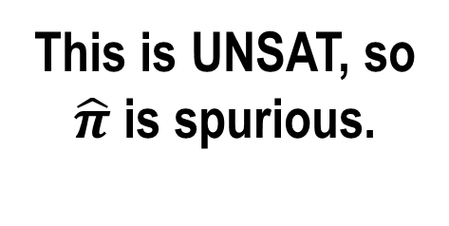
Example Simulation
y₁ = 1 ∧
x₁ = 1 ∧
y₁ > x₁ ∧
y₂ = y₁ − 1 ∧
¬(y₂ > x₀)
int main() {
int x, y; y₁=1; x₁=1;
if (y₁>x₁ )
y₂=y₁−1;
else
y++;
assert(y₂>x₁ );
}
This is UNSAT, so
$\hat{π}$ is spurious.

Slide 27
Refining the Abstraction
C program
1. Compute Abstraction
2. Check Abstraction
[no error]
OK
4. Refine Predicates
3. Check Feasibility
[feasible] report counterexample

Slide 28
Manual Proof!
int main() {
int x, y;
y=1;
x=1;
if (y>x)
y−−;
else
y++;
assert(y>x);
}
{y = 1}
This proof uses
strongest post-conditions
{x = 1 ∧ y = 1}
{x = 1 ∧ y = 1 ∧ ¬y > x}
{x = 1 ∧ y = 2 ∧ y > x}

Slide 29
An Alternative Proof
int main() {
int x, y;
y=1;
x=1;
if (y>x)
y−−;
else
y++;
assert(y>x);
}
We are using weakest pre-conditions here
wp(x:=E, P ) = P [x/E]
wp(S;T,Q) = wp(S,wp(T,Q))
wp(if(c) A else B , P ) =
(B ⇒ wp(A,P)) ∧
(¬B ⇒ wp(B,P))
The proof for the ”true” branch is missing
{¬y > 1 ⇒ y + 1 > 1}
{¬y > x ⇒ y + 1 > x}
{y + 1 > x}
{y > x}

Slide 30
Refinement Algorithms
Using WP
Start with failed guard G
Compute wp(G) along the path
Using SP
Start at the beginning
Compute sp(…) along the path
Both methods eliminate the trace
Advantages / Disadvantages?

